Slide 1









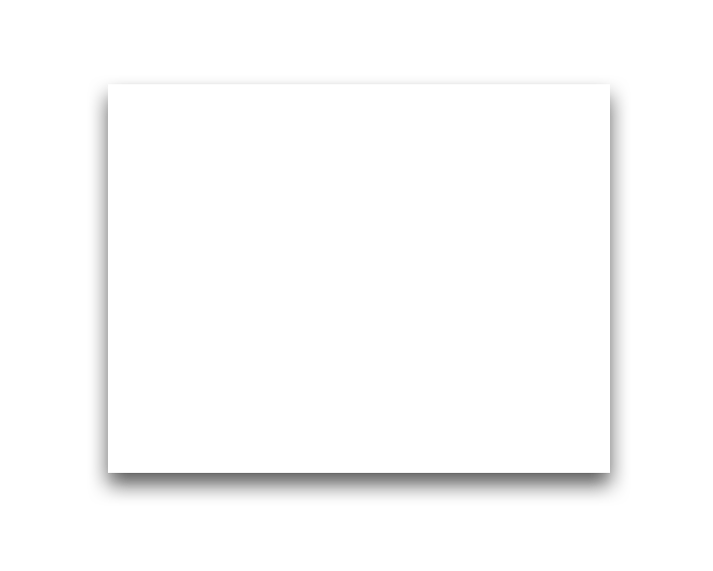

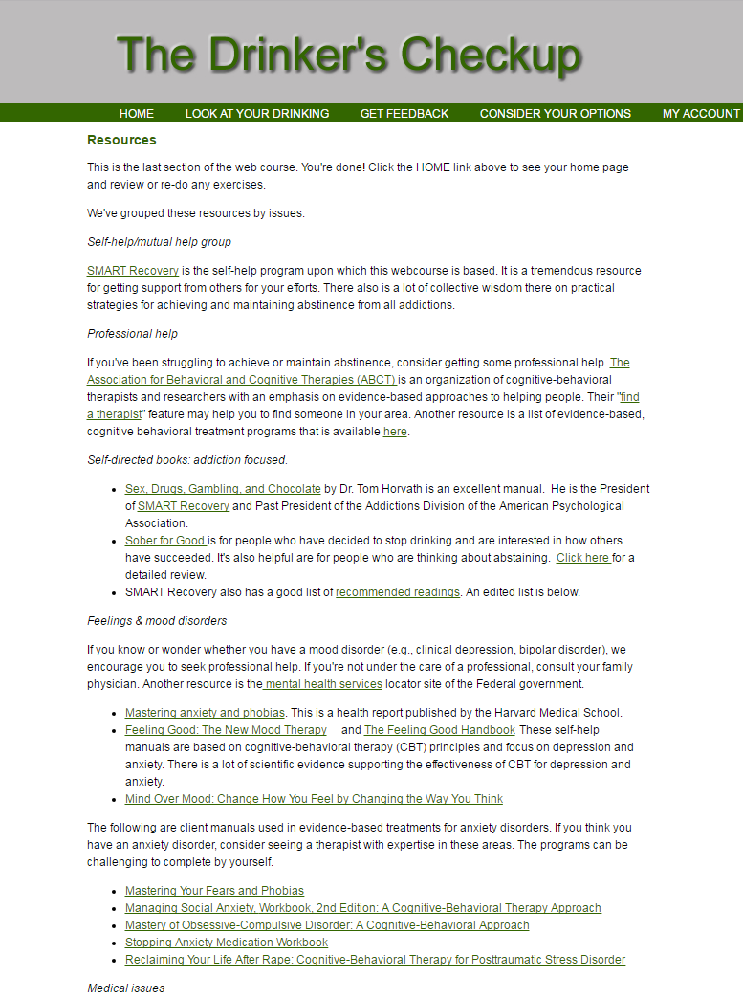
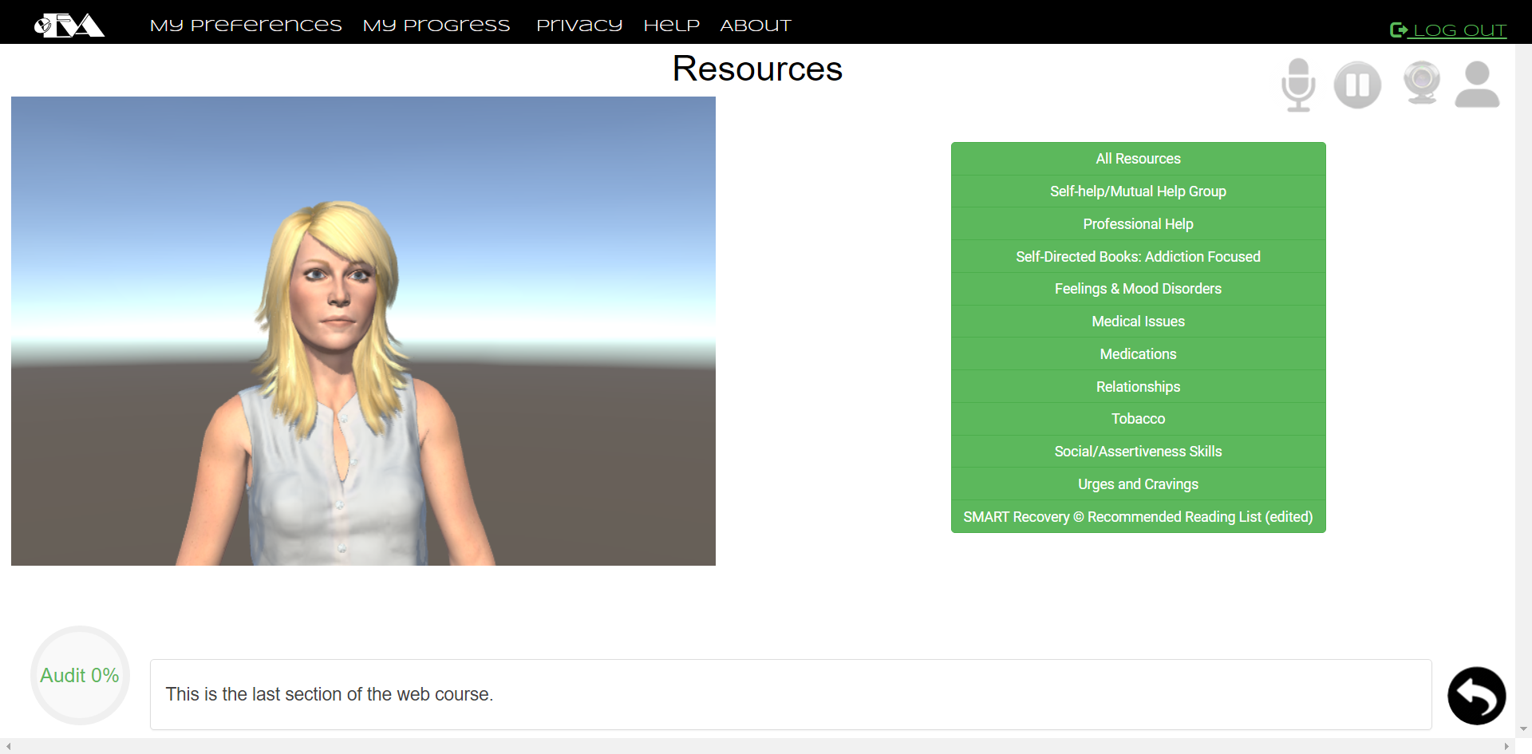
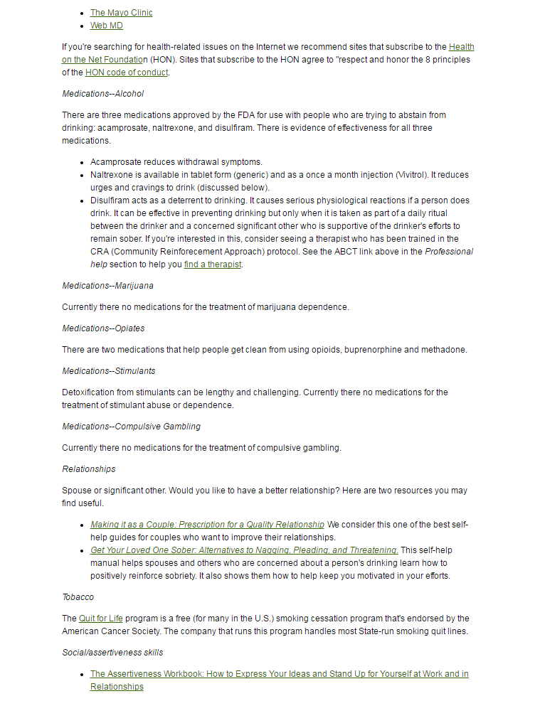
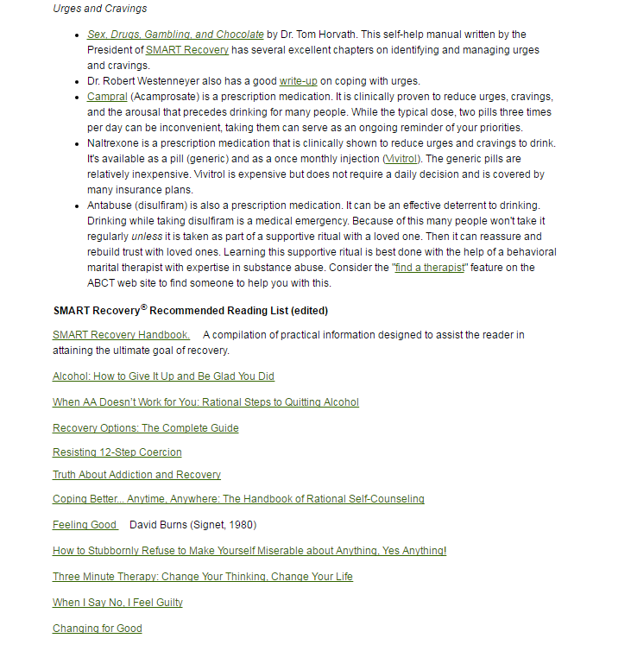
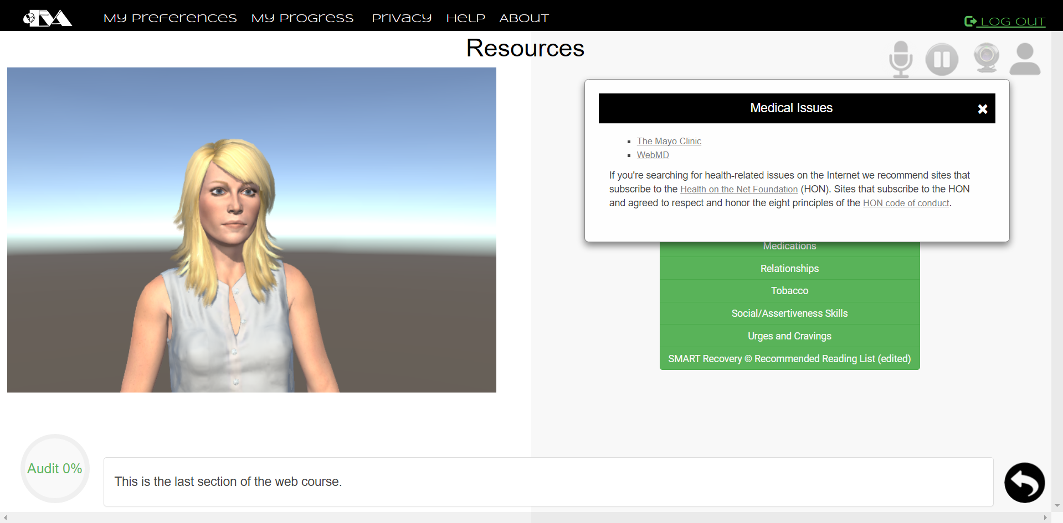
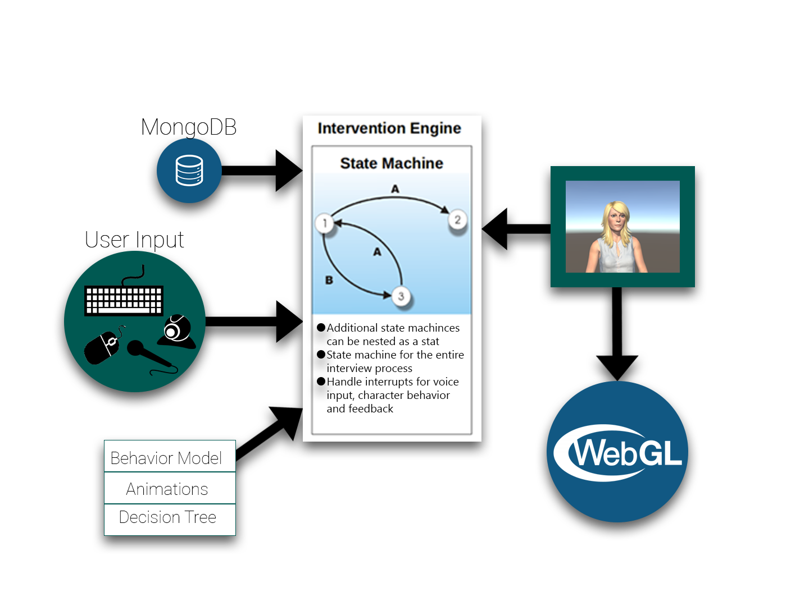
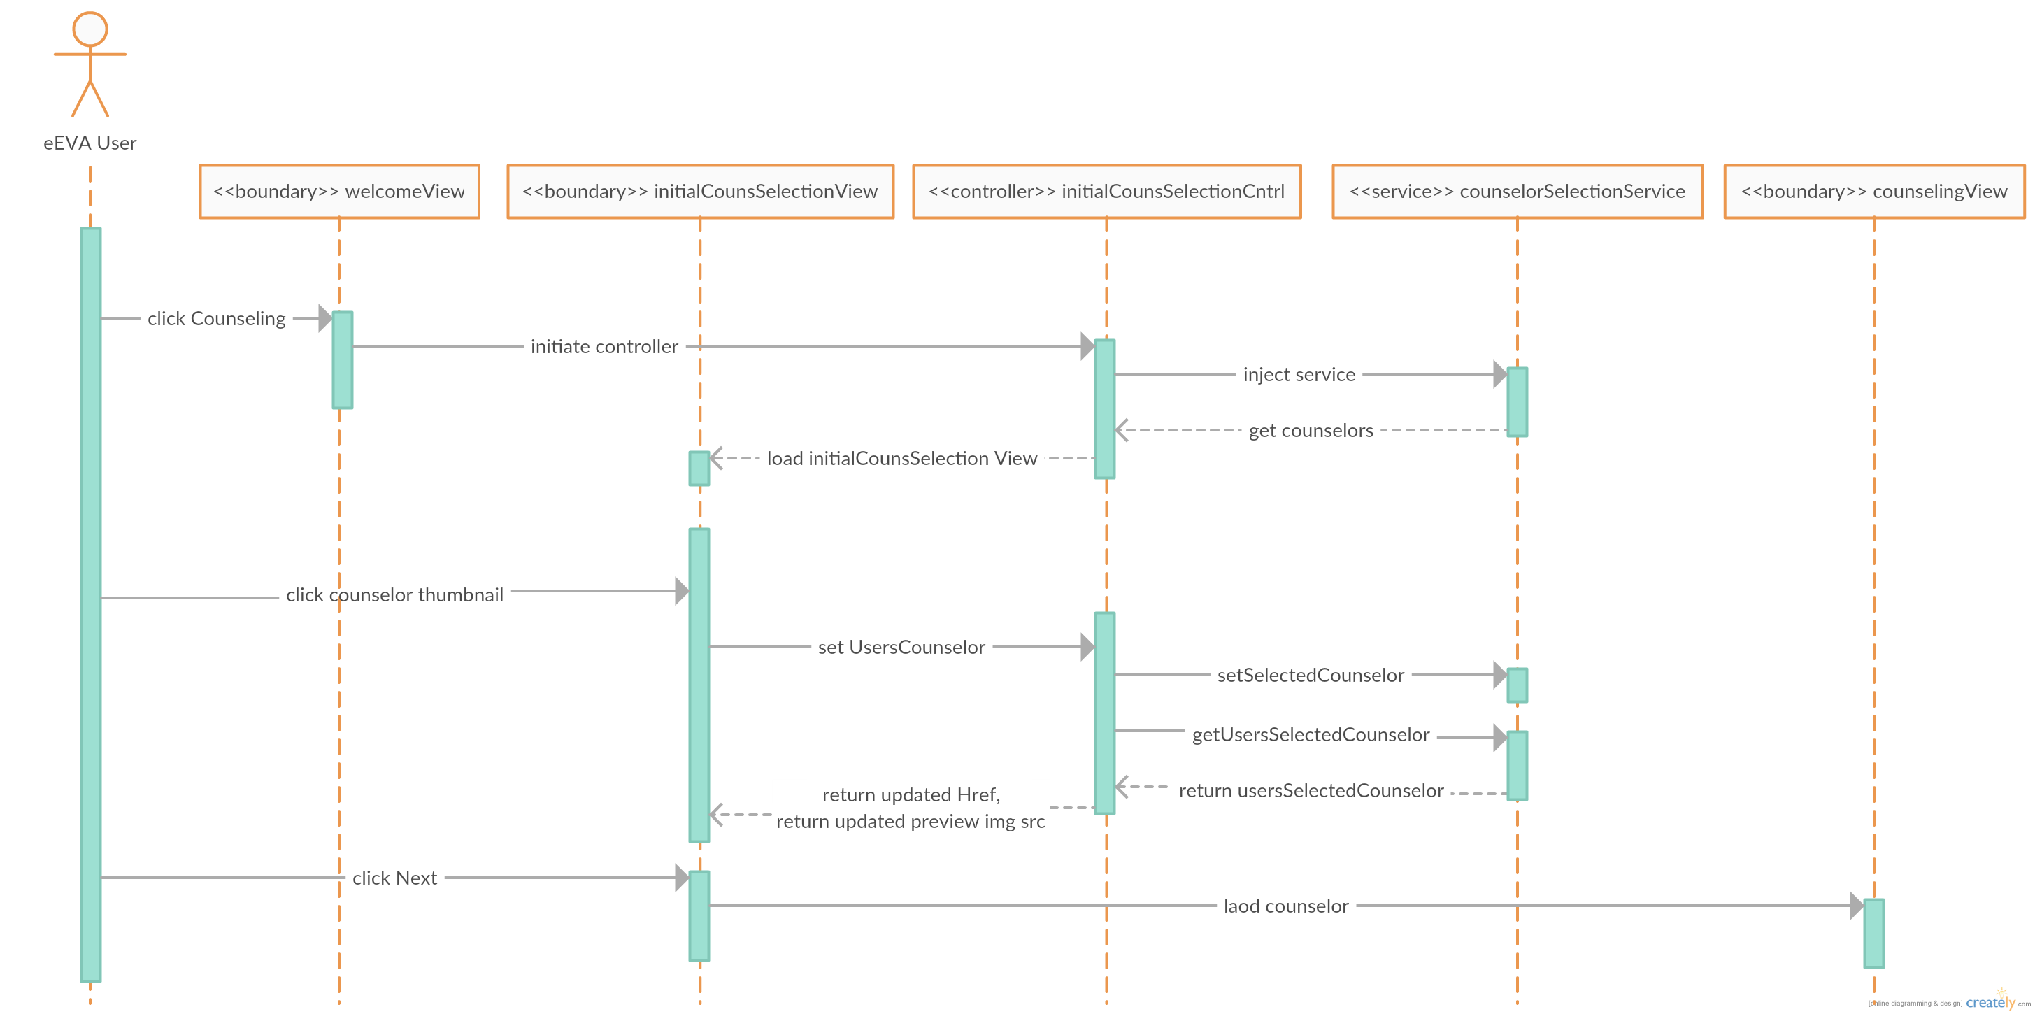
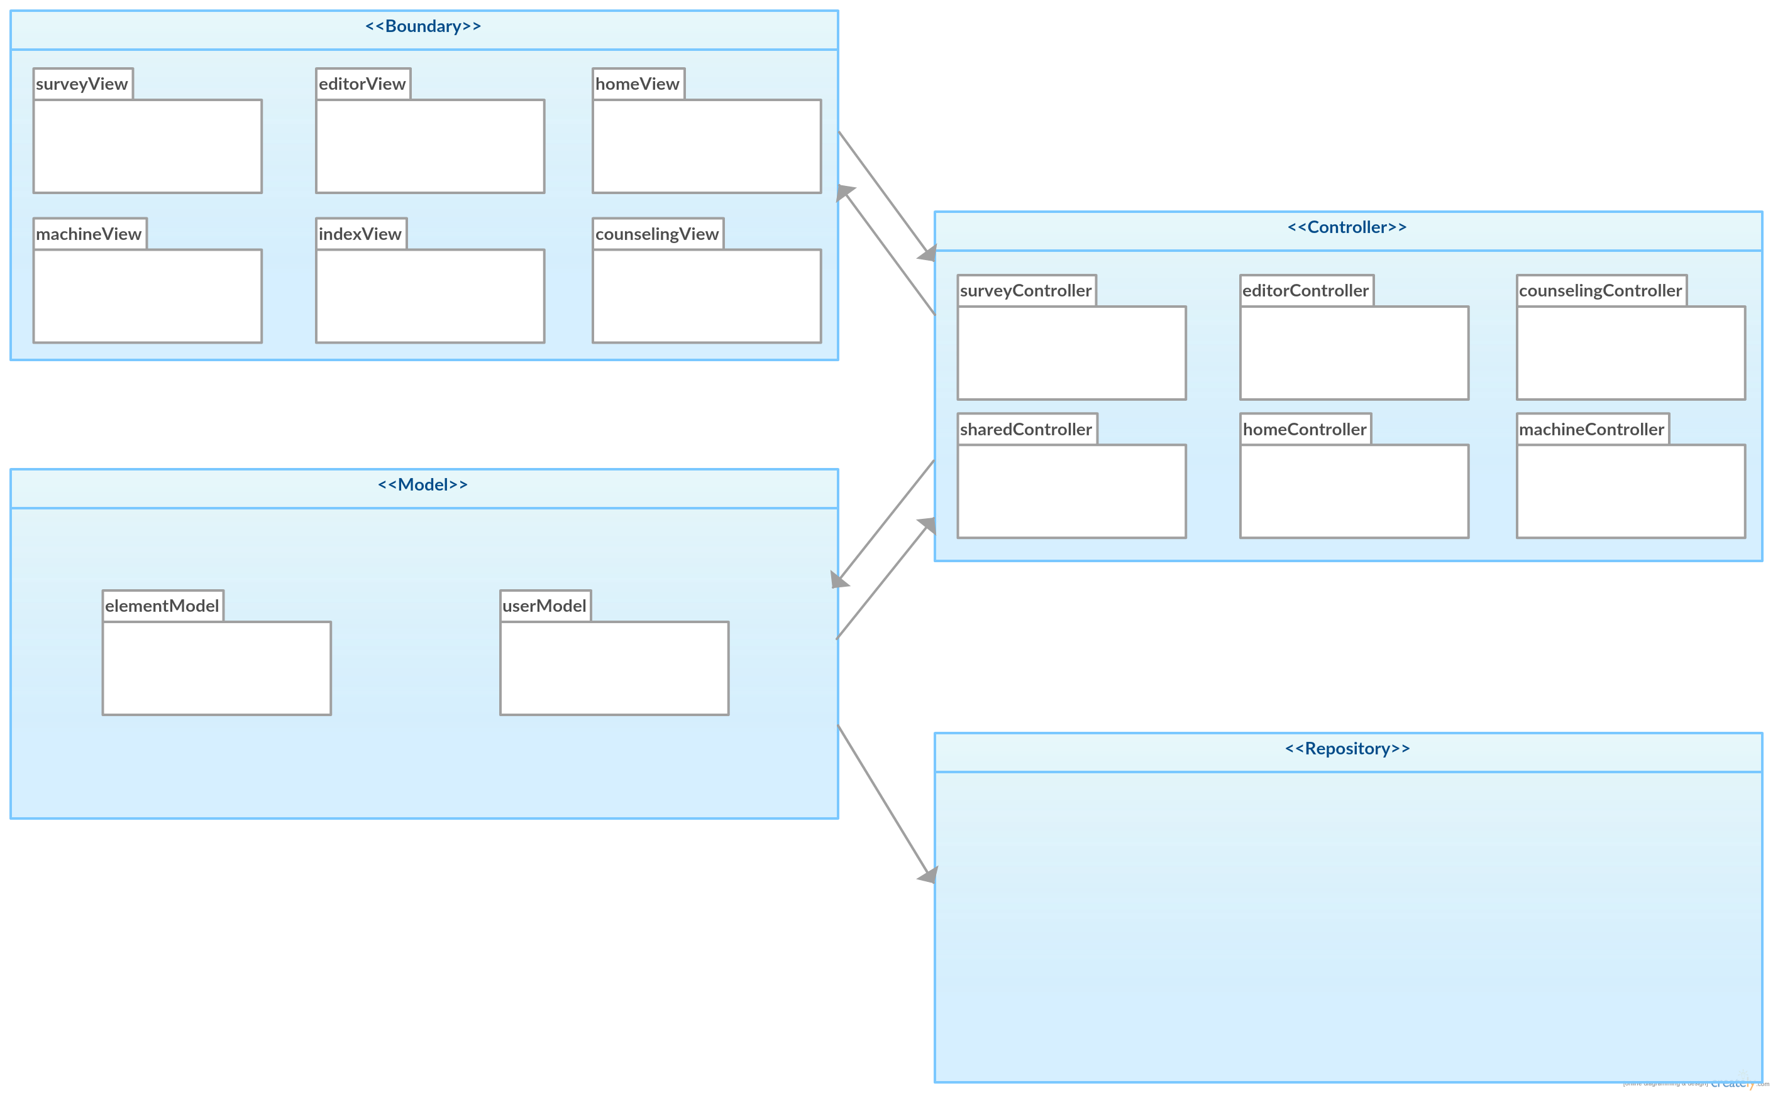
eEVA Data Generation and User Results Analysis 2.0
Student: Emmanuel Henley, Florida International University
Mentors: Dr. Christine Lisetti, Florida International University
Stephanie Lunn, Florida International University
Mohsen Taheri, Florida International University
Instructor: Masoud Sadjadi, Florida International University
Senior Project, Spring 2017
Problem
Current System
Problem
Most individuals affected by alcohol abuse are unaware that there is an issue. Brief Motivation Interventions or BMI’s are evidence-based patient-centered brief interventions designed to help people change at-risk behaviors, such as alcohol abuse. The current Drinkers Check Up lacks engagement due to its heavy reliance on text to administer these brief interventions.
Solution
Utilizes 1 of 5 empathic embodied virtual agents (eEVA) to administer the brief intervention
Utilizes NLP for improved user engagement
Utilizes microphone and keyboard for user input
Displays user’s results
Includes various enhancements (post version 1.0) to improve usability
Create an empathic embodied virtual agent (eEVA), that is capable of:
Administering a brief intervention
Improving user engagement by utilizing NLP (natural language processing)
Displaying empathy based on users emotional response.
Allowing the user the ability to choose their person counselor
Implementation
Screenshots
System was designed using MEAN Stack
The web app interface was made using HTML, CSS, JQuery, Node.js, and Angular.js
Survey content created using the systems built in Survey Editor and State Machine
Content is injected into Webstorm and stored in the database
Intervention Flow
Original Text Based DCU
Version 2.0
Requirements
Object Design
Initial counselor selection menu
3 remaining sections of the intervention:
- The Not So Good Things Revisited
- The Good Things Revisited
- Game Plan
- Game Plan Overview
User resources
Sequence diagram for user story #343
System Design
Verification
The eEVA System utilizes a Model View Controller (MVC) architecture
Example test cases for user story #343
eEVA_IT_InitialCounselorSelection_01 (Sunny Day)
Purpose | To test that once the user clicks the “Next” button on the initial counselor selection page, the selected counselor will load and the counseling session will begin with a brief introduction.
Precondition | The user must have logged on, then from the current welcome page, the user has clicked the “Counseling” tab located in the navbar, the user has made a selection, and lastly the user has clicked next
Expected Result | The counseling session loads with the user’s selected counselor
Actual Result | The counseling session loaded with the user’s selected counselor
Status | Passed
Summary
The eEVA system now includes the following:
Counselor selection (initial and in session)
Ability for user to re-evaluate certain sections of the intervention that were previously answered, post feedback
Allows user to view resources that pertain to their special needs
Allows user to print pertinent information for later viewing
eEVA_IT_InitialCounselorSelection_02 (Rainy Day)
Purpose | To test that when the user clicks a counselor thumbnail on the counselor selection page, the counseling session does NOT begin, i.e., the page does not redirect and the user is kept on the initial counselor selection.
Precondition | The user must have logged on, then from the current welcome page, the user has clicked counseling
Expected Result | The counseling session does not load
Actual Result | The counseling session DID NOT load
Status | Passed
Acknowledgement
The work in this poster is based upon the efforts of Dr. Christine Lisetti and the Affective Social Computing Laboratory (http://ascl.cis.fiu.edu/), with thanks to the National Science Foundation for their support. I am also grateful to my fellow team member, Andy Regueira .
Notes:
1

